Slide 1
BITS Pilani
Dr. Lavika Goel
Assistant Professor
Department of CSIS
Lecture 9: 30/3/2019
Pilani Campus

Slide 2
Pilani Campus
CROSS LANGUAGE IR
3/29/2019 SS ZG537 (INFORMATION RETRIEVAL) 2

Slide 3
Agenda
Cross Language IR
Statistical MT – IBM model1 word based MT
3/29/2019 SS ZG537 (INFORMATION RETRIEVAL) 3
Pilani Campus

Slide 4
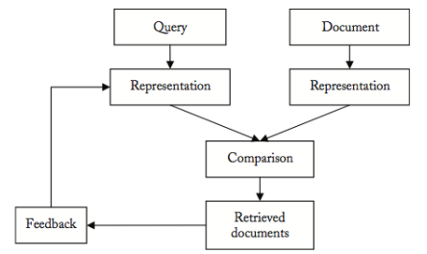
IR in a picture
3/29/2019 SS ZG537 (INFORMATION RETRIEVAL) 4
Pilani Campus

Slide 5
Cross Language IR
Queries and documents are described in different languages. E.g.:
query: “major earthquakes in recent year”
We want to retrieve both passages below:
There is a major earthquake in Wenchuan, China in 2008 (EN)
Un tremblement de terre violent a Wenchuan secoue la Chine en 2008 (FR)
3/29/2019 SS ZG537 (INFORMATION RETRIEVAL) 5
Pilani Campus

Slide 6
Motivations
The relevant document may not exist in the user’s native language
User intend to ﬁnd all the relevant information available, whatever language is used(e.g. searching for patents)
User could be able to read documents in language different from the native one, but could have difﬁculty in formulating queries in those languages
3/29/2019 SS ZG537 (INFORMATION RETRIEVAL) 6
Pilani Campus

Slide 7
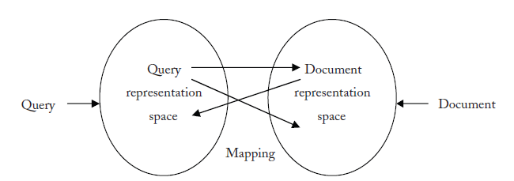
Mapping between representation spaces
In English Computers, Computer, Computing are represented
as Comput after Stemming
Same concept can be represented as different terms in
different languages where the terms are not comparable.
Key issue in CLIR is to develop tools that match terms in
different languages having same meaning.
3/29/2019 SS ZG537 (INFORMATION RETRIEVAL) 7
Pilani Campus

Slide 8
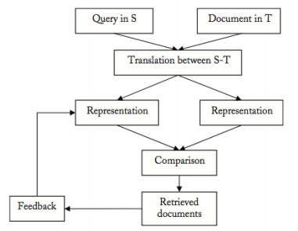
CLIR in a picture
3/29/2019 SS ZG537 (INFORMATION RETRIEVAL) 8
Pilani Campus

Slide 9
Mapping / Translation process
The Translations can be used in several ways
Mapping the document representation into the query representation space: document translation
Mapping the Query representation into the document representation space: Query translation
Mapping the both document and query representations into third space.
3/29/2019 SS ZG537 (INFORMATION RETRIEVAL) 9
Pilani Campus
Notes:
The translation module could use one of the following approaches:
Document translation Mapping the document representation into the query rep.
• Pro: more context but current MT systems don’t exploit the context much
• Contra: one has to determine in advance to which language each document
should be translated, all the translated versions should be stored.
Query translation Mapping the query representation into the document representation
• Pro: flexible, more interaction with the user (who could choose the languages
of interest, can correct the translation.)
• Contra: translation ambiguity amplified by the lack of context.
Inter-lingua translation Mapping document and query representation to a 3rd language
• Pro: useful if there is no resource for a direct translation.
• Contra: lower performance that the direct translation
Most used approach in CLIR: Query translation

Slide 10
Companies & CLIR
2006 Yahoo!: translates queries in French and German to English, Spanish, Italian and French/German
2007 Google: searching without boundaries
here: CLS (Cross Library Service)
3/29/2019 SS ZG537 (INFORMATION RETRIEVAL) 10
Pilani Campus

Slide 11
Basic terminology
A bitext is a pair of texts such that one is a translation of the other.
A tritext is a triple of texts such that they are each a translation of the others.
Parallel corpora include bitexts, tritexts, and any set of N texts, such that each is a translation of the others.
Parallel corpora tend towards literal translations(word-for-word translation).
3/29/2019 SS ZG537 (INFORMATION RETRIEVAL) 11
Pilani Campus
Notes:
In the field of translation studies a bitext is a merged document composed of both source- and target-language versions of a given text.
Bitexts are generated by a piece of software called an alignment tool, or a bitext tool, which automatically aligns the original and translated versions of the same text. The tool generally matches these two texts sentence by sentence. A collection of bitexts is called a bitext database or a bilingual corpus, and can be consulted with a search tool.

Slide 12
Statistical MT
Statistical MT relies on translation examples contained in a parallel corpus, i.e., a set of texts translated into another language.
Such a corpus can be further processed into aligned sentences
Word-to-word translation
Phrase-based translation
Syntax-based translation (tree-to-tree, tree-to-string)
Trained on parallel corpora
Usually noisy-channel (at least in spirit)
3/29/2019 SS ZG537 (INFORMATION RETRIEVAL) 12
Pilani Campus

Slide 13
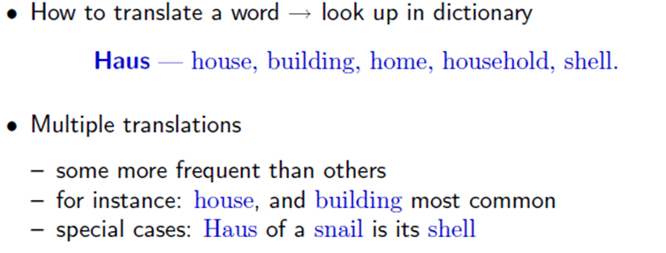
Word-based models
Lexical Translation
3/29/2019 SS ZG537 (INFORMATION RETRIEVAL) 13
Pilani Campus

Slide 14
Formulating the problem
Input is the Source language: f(Foreign)
Output is the Target language: e(English)
Foreign text (F)
English text (E)
Many possible translations from F – E
T1
We can model these differences of opinion with a probability distribution P(E|F) over possible translations, E, given that the Foreign text was F.
A reasonable way of choosing the “best” translation is to choose which maximizes the conditional probability P(E|F)
T2
different opinions
From F - E
.
.
Tn
unknown
3/29/2019 SS ZG537 (INFORMATION RETRIEVAL) 14
Pilani Campus
Notes:
We will try to create English sentences e that best represent foreign sentence f.
http://michaelnielsen.org/blog/introduction-to-statistical-machine-translation/

Slide 15
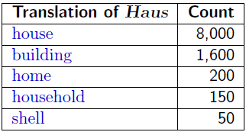
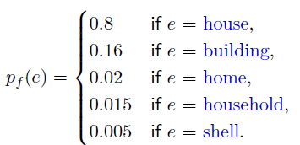
Collect Statistics
Look at a parallel corpus (German text along with English translation)
10,000 occurrences of the word Haus
Estimate Translation Probabilities
Maximum likelihood estimation
3/29/2019 SS ZG537 (INFORMATION RETRIEVAL) 15
Pilani Campus

Slide 16
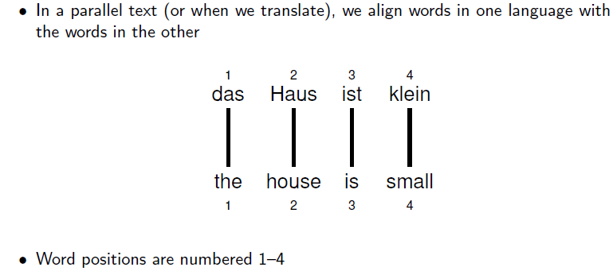
Alignment
3/29/2019 SS ZG537 (INFORMATION RETRIEVAL) 16
Pilani Campus

Slide 17
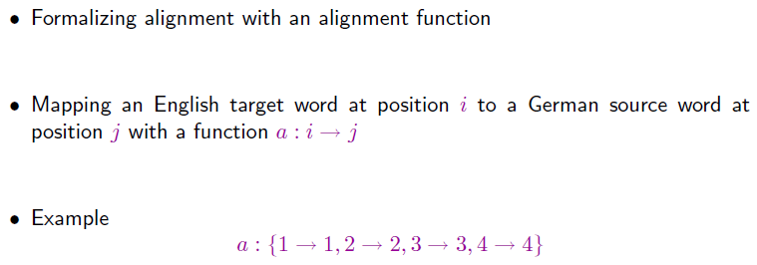
Alignment Function
3/29/2019 SS ZG537 (INFORMATION RETRIEVAL) 17
Pilani Campus

Slide 18
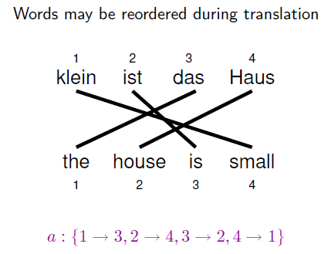
Reordering
3/29/2019 SS ZG537 (INFORMATION RETRIEVAL) 18
Pilani Campus

Slide 19
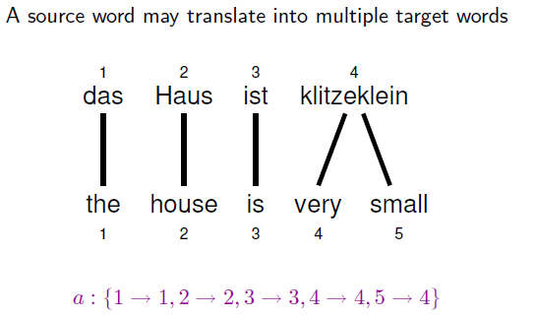
One-to-Many Translation
3/29/2019 SS ZG537 (INFORMATION RETRIEVAL) 19
Pilani Campus
Notes:
http://videolectures.net/hltss2010_eisner_plm/
http://videolectures.net/clspss09_lopez_mt/
http://michaelnielsen.org/blog/introduction-to-statistical-machine-translation/

Slide 20
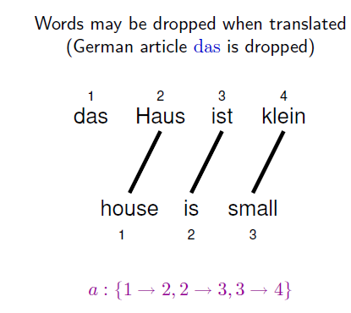
Dropping Words
3/29/2019 SS ZG537 (INFORMATION RETRIEVAL) 20
Pilani Campus

Slide 21
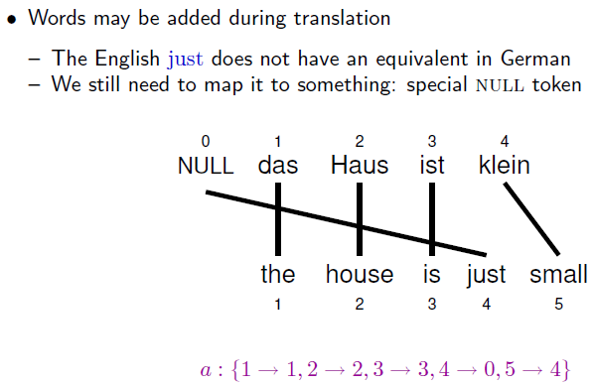
Inserting Words
3/29/2019 SS ZG537 (INFORMATION RETRIEVAL) 21
Pilani Campus

Slide 22
IBM Model 1
How do we model P(e|f)?
English sentence e has m words e₁,e₂..e_{m}
Foreign sentence f has l words f₁,f₂..fl
An alignment a identifies which English word each foreign word is originated from?
Formally an alignment a is {a₁,,a₂…a_{m}} where each
a_{j} Є {0.. l}
There are (l+1)^{m} possible alignments
3/29/2019 SS ZG537 (INFORMATION RETRIEVAL) 22
Pilani Campus

Slide 23
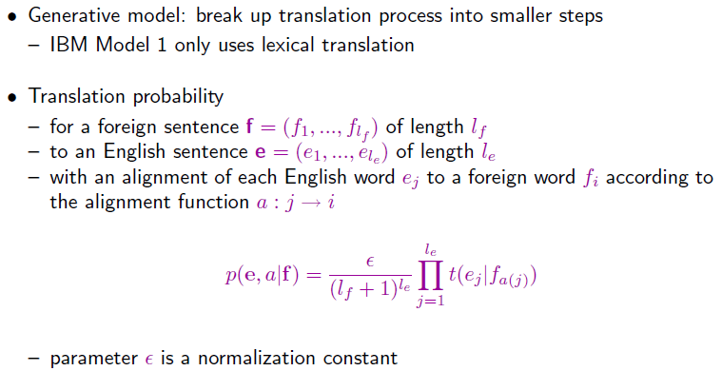

IBM Model 1
Input is the Source language: f(Foreign)
Output is the Target language: e(English)
Product over all words in English sentence
normalization
lexical translation probabilities for all l_{e}
generated output words e_{j}
No of alignments possible (l_{f}+1)^{le}
3/29/2019 SS ZG537 (INFORMATION RETRIEVAL) 23
Pilani Campus
Notes:
T(e_{j}|f_{a(j)}) each of these English words are assumed to come from some foreign word. Which foreign word it came from? It came from the j^{th} foreign word it is aligned with.

Slide 24
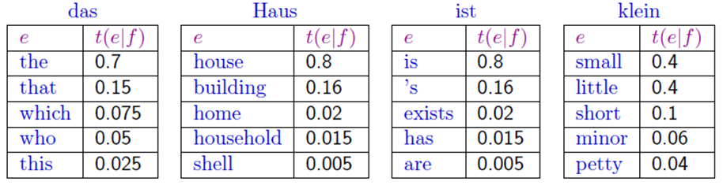
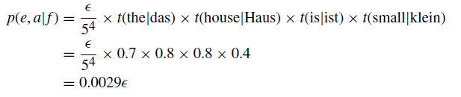
Example
Translation score
if we know the parameters t for this Translation model
3/29/2019 SS ZG537 (INFORMATION RETRIEVAL) 24
Pilani Campus

Slide 25
IBM Model 1 and EM
EM Algorithm consists of two steps
Expectation-Step: Apply model to the data
parts of the model are hidden (here: alignments)
using the model(given alignments), assign probabilities to possible values
Maximization-Step: Estimate model from data
take assign values as fact
collect counts (weighted by probabilities)
estimate model from counts
Iterate these steps until convergence
Output:
Alignments
3/29/2019 SS ZG537 (INFORMATION RETRIEVAL) 25
Pilani Campus

Slide 26
IBM Model 1 and EM
We need to be able to compute:
Expectation-Step: probability of alignments
Maximization-Step: count collection (Counting up how many times the words get alignment to each other)
3/29/2019 SS ZG537 (INFORMATION RETRIEVAL) 26
Pilani Campus

Slide 27
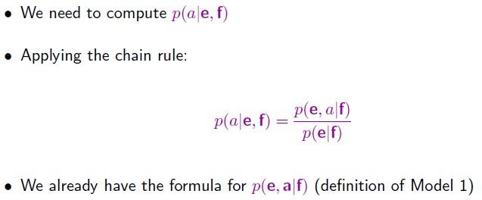
IBM Model 1 and EM: Expectation Step
Compute the probability of an alignment given a complete English Foreign Sentence pair.
P(e,a|f) probability of English sentences and alignment given a foreign sentence
So we need to compute the probability of english string given a foreign string p(e|f)
3/29/2019 SS ZG537 (INFORMATION RETRIEVAL) 27
Pilani Campus

Slide 28
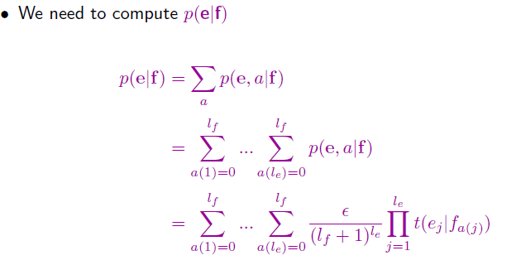
IBM Model 1 and EM: Expectation Step
Marginalize over all the alignments
For every alignment
For every word in e aligned to f
Definition of IBM model -1
3/29/2019 SS ZG537 (INFORMATION RETRIEVAL) 28
Pilani Campus

Slide 29
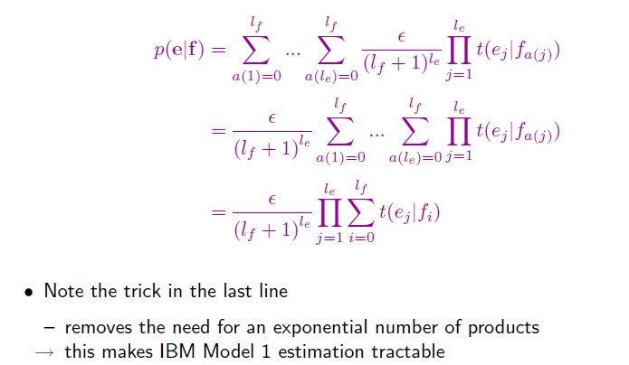
IBM Model 1 and EM: Expectation Step
Probability of an alignment is constant
Messy sums and then a product
Sum over products
products over Sum
3/29/2019 SS ZG537 (INFORMATION RETRIEVAL) 29
Pilani Campus

Slide 30
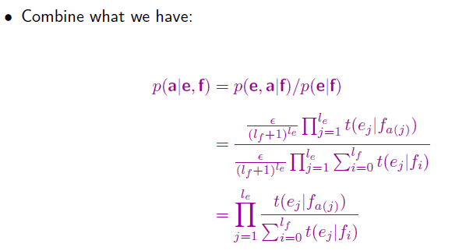
IBM Model 1 and EM: Expectation Step
Combining the definition of model 1 with the marginalized Probability
The probability of an alignment is nothing but probability of the translations given the alignmnet.
3/29/2019 SS ZG537 (INFORMATION RETRIEVAL) 30
Pilani Campus

Slide 31
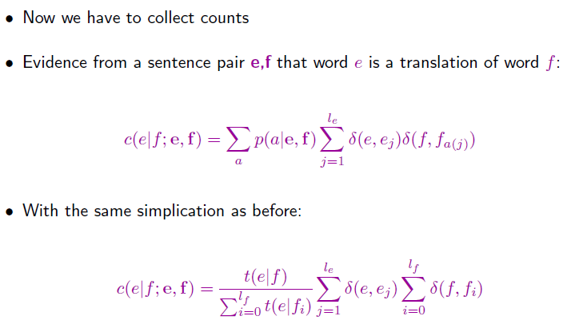
IBM Model 1 and EM: Maximization Step
count where single word in e is translated from the single foreign word f given the
English sentence e and foreign sentence f.
Sum over all possible alignments
The number of times the English word e was
Aligned with foreign word f in that alignment.
3/29/2019 SS ZG537 (INFORMATION RETRIEVAL) 31
Pilani Campus

Slide 32
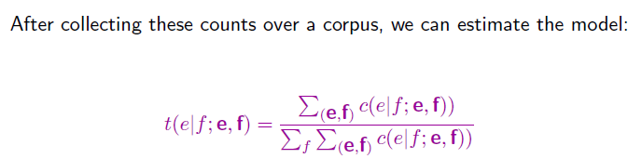
IBM Model 1 and EM: Maximization Step
The probability of translating English word e from foreign word f just summing over
all sentences in the corpus
3/29/2019 SS ZG537 (INFORMATION RETRIEVAL) 32
Pilani Campus

Slide 33
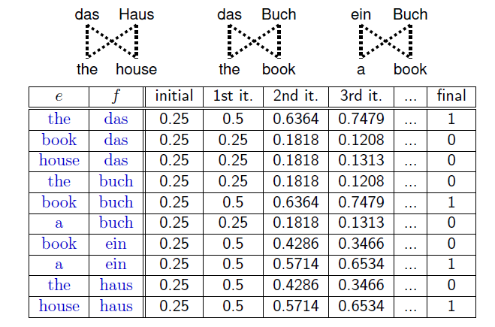
Convergence
3/29/2019 SS ZG537 (INFORMATION RETRIEVAL) 33
Pilani Campus

Slide 34
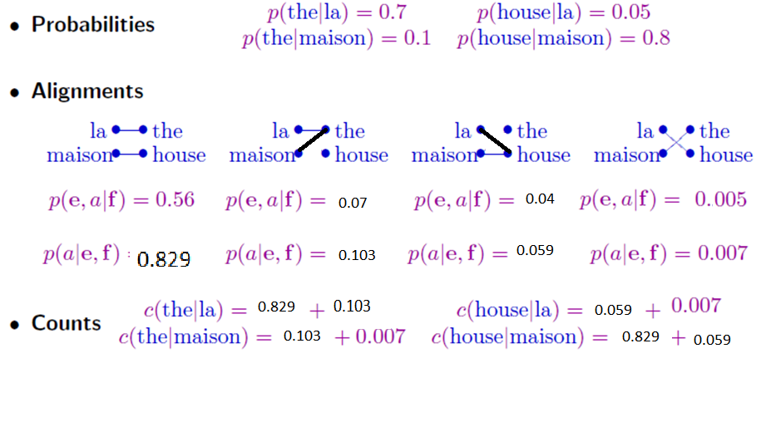
IBM Model 1 and EM
Given some initial word translation probabilities
we can compute the probability of alignment
What is the probability of alignment where the was aligned to la
Given probability of alignments we can compute the expected count
3/29/2019 SS ZG537 (INFORMATION RETRIEVAL) 34
Pilani Campus

Slide 35
Exercise
Consider the following sentences as parallel corpus
Sentence 1:
f1: kutta bhouka
e1: dog barked
Sentence 2:
f2: kutta kata kutta
e2: dog bit dog
3/29/2019 SS ZG537 (INFORMATION RETRIEVAL) 35
Pilani Campus

Slide 36
Exercise (contd..)
Step 1 – Initialization: Set all translation parameters uniformly
Since there are 3 English words all p(e|f) is set to 1/3.
Step 2 – Alignments: compute p(a,e|f) and p(a|e,f)
S1 can be generated using the following 4 different alignments:
a1={<0,0><0,1>} a2={<1,0><1,1>} a3={<0,0><1,1>} a4={<0,1><1,0>}
Each p(a,e|f) can be generated with a probability for ex. a1 can be computed
by p(0|0) X p(0|1) = p(dog|kutta) X p(dog|bhouka) = 1/3X1/3 = 1/9
a1=1/9,a2=1/9,a3=1/9,a4=1/9
p(dog|kutta) = 1/3 | p(bit|kutta) = 1/3 | p(barked|kutta) = 1/3
p(dog|bhouka) = 1/3 | p(bit|bhouka) = 1/3 | p(barked|bhouka) = 1/3
p(dog|kata) = 1/3 | p(bit|kata) = 1/3 | p(barked|kata) = 1/3
3/29/2019 SS ZG537 (INFORMATION RETRIEVAL) 36
Pilani Campus

Slide 37
Exercise (contd..)
S2 can be generated using the following 13 different alignments:
a1={<0,0><0,1><0,2>} a2={<1,0><1,1><1,2>} a3={<2,0><2,1><2,2>}
a4={<0,0><1,1><2,2>} a5={<0,0><1,2><2,1>} a6={<0,1><1,0><2,2>}
a7={<0,2><1,1><2,0>} a8={<0,0>,<1,1>,<1,2>}a9={<0,0>,<2,1>, <2,2>}
a10={<0,0>, <0,1>, <2,2>} a11={<1,0>, <1,1>, <2,2>} a12={<0,0>, <0,2>, <1,1>} a13={< 2,0>, >2,2>, <1,1>}
Compute p(a,e|f) for each alignment
a1= P(0|0) x P(0|1) x P(0|2) = P(dog|kutta) x P(dog|kata) x P(dog|kutta)
= 1/3x1/3x1/3 = 1/27
a2 = 1/27
a3 = 1/27
a4 = 1/27
a5 = 1/27
a6 = 1/27
a7 = 1/27
a8 = 1/27
a9 = 1/27
a10 = 1/27
a11= 1/27
a12 = 1/27
a13= 1/27
3/29/2019 SS ZG537 (INFORMATION RETRIEVAL) 37
Pilani Campus

Slide 38
Exercise (contd..)
Step3:Compute p(a|e,f) for each alignment normalize the values
S1
a1=1/9 p(a1|e,f) = (1/9)/1/9+1/9+1/9+1/9 = 1/4
a2=1/9 p(a2|e,f) = (1/9)/1/9+1/9+1/9+1/9 = 1/4
a3=1/9 p(a3|e,f) = (1/9)/1/9+1/9+1/9+1/9 = 1/4
a4=1/9 p(a4|e,f) = (1/9)/1/9+1/9+1/9+1/9 = 1/4
S2
a1 = 1/27 p(a1|e,f) = (1/27)/ (1/27+1/27+..+1/27 (13 times)) = 1/13
a2 = 1/27 p(a2|e,f) = 1/13
a3 = 1/27 p(a3|e,f) = 1/13
a4 = 1/27 p(a4|e,f) = 1/13
a5 = 1/27 p(a5|e,f) = 1/13
a6 = 1/27 p(a6|e,f) = 1/13
a7 = 1/27 p(a7|e,f) = 1/13
a8 = 1/27 p(a2|e,f) = 1/13
a9 = 1/27 p(a3|e,f) = 1/13
a10 = 1/27 p(a4|e,f) = 1/13
a11= 1/27 p(a5|e,f) = 1/13
a12 = 1/27 p(a6|e,f) = 1/13
a13 = 1/27 p(a7|e,f) = 1/13
3/29/2019 SS ZG537 (INFORMATION RETRIEVAL) 38
Pilani Campus

Slide 39
Exercise (contd..)
Step4:Take the counts for each translations over the whole corpus i.e observe in the whole corpus how many times each words have been aligned and add their p(a|e,f)
Step5:Normalize fractional counts to get revised parameter values
Note: Correct translation probabilities increase for ex dog, kutta from the initial uniform probability
c(dog|kutta) = 35/26 | c(bit|kutta) = 6/13 | c(barked|kutta) = 1/2
c(dog|bhouka) = 1/2 | c(bit|bhouka) = 0 | c(barked|bhouka) = 1/2
c(dog|kata) = 6/13 | c(bit|kata) = 7/13 | c(barked|kata) = 0
c(dog|kutta) = 35/60 | c(bit|kutta) = 1/5 | c(barked|kutta) = 13/60
c(dog|bhouka) = 1/2 | c(bit|bhouka) = 0 | c(barked|bhouka) = 1/2
c(dog|kata) = 6/13 | c(bit|kata) = 7/13 | c(barked|kata) = 0
3/29/2019 SS ZG537 (INFORMATION RETRIEVAL) 39
Pilani Campus

Slide 40
Exercise (contd..)
Repeat from step 2-5 until convergence
for ex after 5 iterations
p(dog|kutta) = 0.9999
p(bit|kutta) = 0.0001
p(barked|kutta) = 0.0001
p(dog|bhouka) = 0.0001
p(bit|bhouka) = 0.0001
p(barked|bhouka) = 0.9999
p(dog|kata) = 0.0001
p(bit|kata) = 0.9999
p(barked|kata) = 0.0001
3/29/2019 SS ZG537 (INFORMATION RETRIEVAL) 40
Pilani Campus
Notes:
Step2:compute p(a,e|f) and p(a|e,f)
S1 can be generated using the following 4 different alignments:
a1={<0,0><0,1>} a2={<1,0><1,1>} a3={<0,0><1,1>} a4={<0,1><1,0>}
Each p(a,e|f) can be generated with a probability for ex. a1 can be computed
by p(0|0) X p(0|1) = p(dog|kutta) X p(dog|bhouka) = 17/29X7/11 = 119/319
a1=1/9,a2=1/9,a3=1/9,a4=1/9

Slide 41
Pilani Campus
Phrase based SMT
3/29/2019 SS ZG537 (INFORMATION RETRIEVAL) 42

Slide 42
Agenda
Phrase-Based Model
Phrase translation table
3/29/2019 SS ZG537 (INFORMATION RETRIEVAL) 42
Pilani Campus

Slide 43
Motivation
Word-Based Models translate words as atomic units
Phrase-Based Models translate phrases as atomic units
Advantages:
many-to-many translation can handle non-compositional phrases
use of local context in translation
the more data, the longer phrases can be learned
"Standard Model", used by Google Translate,Microsoft and others
3/29/2019 SS ZG537 (INFORMATION RETRIEVAL) 43
Pilani Campus
Notes:
But words may not be the best candidates for the smallest units for translation.
Sometimes one word in a foreign language translates into two English words, or vice versa.
Word-based models often break down in these cases.

Slide 44
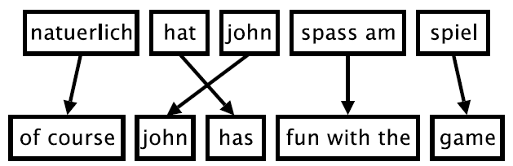
Phrase-Based Model
Six German words
Eight English words
Foreign input is segmented in phrases(Phrase segmentation )
Each phrase is translated into English(Phrase translation)
Phrases are reordered so that the verb follows the subject.(Output ordering)
3/29/2019 SS ZG537 (INFORMATION RETRIEVAL) 44
Pilani Campus

Slide 45
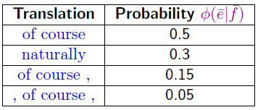
Phrase translation table
Main knowledge source: table with phrase translations and their probabilities
Example: phrase translations for natuerlich
3/29/2019 SS ZG537 (INFORMATION RETRIEVAL) 45
Pilani Campus

Slide 46
Advantages
Words may not be the best atomic units for translation, due to frequent one-to-many mappings (and vice versa).
Translating word groups instead of single words helps to resolve translation ambiguities.
if we have large training corpora, we can learn longer and longer useful phrases, sometimes even memorize the translation of entire sentences.
3/29/2019 SS ZG537 (INFORMATION RETRIEVAL) 46
Pilani Campus

Slide 47
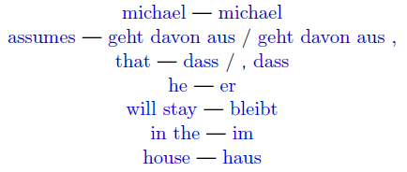
Phrase based Models
First stage in training a phrase based model is extraction of a Phrase-based (PB) lexicon
A PB lexicon pairs strings in one langauge with strings in other language.e.g.,
English
Spanish
One or more words on either side of the source or target language and number of words
could differ
3/29/2019 SS ZG537 (INFORMATION RETRIEVAL) 47
Pilani Campus
Notes:
These translations form the basis of the translation systems

Slide 48
Example
A training example(E/F sentence pair)
F f1 f2 f3 f4 f5 f6 f7 f8 f9
E Mary did not slap the green witch
(Mary,f1) (not,f2) (slap,f3f4f5) (the,f7)(green,f8)(witch,f9)
IBM models
Extract phrase pairs form the above alignment
Run some algorithm on
Form Each of the sentences
Extract phrase pairs
E
F
3/29/2019 SS ZG537 (INFORMATION RETRIEVAL) 48
Pilani Campus

Slide 49
Alignment Matrix
FOREIGN
 | f1 | f2 | f3 | f4 | f5 | f6 | f7 | f8 | f9
Mary
did
Not
Slap
the
green
witch
E
N
G
L
I
S
h
Each foreign word is aligned to exactly one English word observe that there is
One single dot in each column
3/29/2019 SS ZG537 (INFORMATION RETRIEVAL) 49
Pilani Campus

Slide 50
Issues with the alignments
Alignments contain noise or they are erroneous.
Many to one (i.e each word in Foreign language is aligned to one word in English).This constraint is not realistic
3/29/2019 SS ZG537 (INFORMATION RETRIEVAL) 50
Pilani Campus

Slide 51
Finding alignment matrices
Step 1: Train IBM Model for P(f|e) and come with the most likely alignment for each (e,f) pair.
Step 2: Train IBM Model for P(e|f) and come with the most likely alignment for each (e,f) pair.
We now have two alignments: take union of the two alignments as a starting point.
3/29/2019 SS ZG537 (INFORMATION RETRIEVAL) 51
Pilani Campus

Slide 52
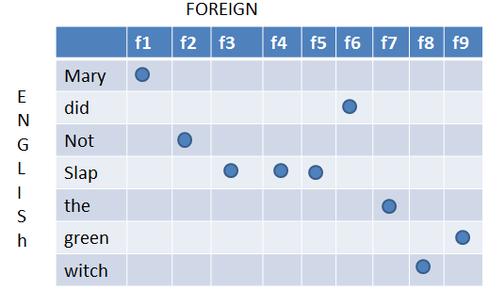
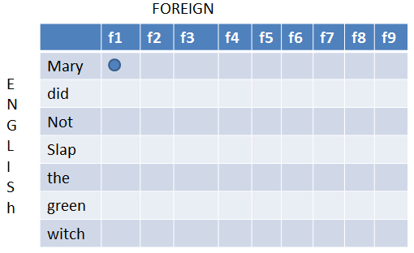
Alignment from P(e|f) model
Alignment from P(f|e) model
Constrained by each f aligned to one e
Constrained by each e aligned to one f
For ex each row has one alignment
union of alignment
3/29/2019 SS ZG537 (INFORMATION RETRIEVAL) 52
Pilani Campus

Slide 53
Extracting phrase pairs from the alignment matrix
A phrase pair consist of a sequence of English words e, paired with a sequence of foreign words, f.
A phrase pair (e,f) is consistent if
1) There is at least one word in e aligned to a word in f
2)There are no words in f aligned to words outside
3) There are no words in e aligned to words outside f
(Mary did not,f1,f2) is consistent
(Mary did,f2) is not consistent
We extract all consistent phrase
pairs for the training example.
3/29/2019 SS ZG537 (INFORMATION RETRIEVAL) 53
Pilani Campus
Notes:
Extract all possible phrase pairs that are consistent with alignment
How to check if a phrase pairs are consistent with alignments?
Mary did not, f1,f2
No alignment points in rows corresponds to 3
No alignment points in colunmns corresponds to 2

Slide 54
Probabilities for Phrase Pairs
For any phrase pair(f,e) extracted from the training data, we can calculate
t(f|e) = count(f,e) / count e
e.g.,
t(f3,f4,f4|slap) = count(f3 f4 f5)/count(slap)
3/29/2019 SS ZG537 (INFORMATION RETRIEVAL) 54
Pilani Campus

Slide 55
Pilani Campus
Phrase based translation model
3/29/2019 SS ZG537 (INFORMATION RETRIEVAL) 55

Slide 56
Mathematical Definition
We use Bayes rule to reformulate the translation probability for translating a foreign sentence f into English e as p(e|f)
argmax_{e} p(e|f) = argmax_{e} p(f|e) p(e)
This allows for a translation model p(f|e) and a separate language model p(e).
This is exactly the same reformulation that we have already seen for word-based models.
3/29/2019 SS ZG537 (INFORMATION RETRIEVAL) 56
Pilani Campus

Slide 57
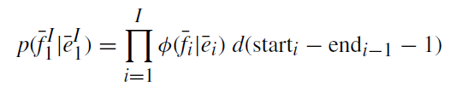

Mathematical Definition(Contd..)
We decompose p(f|e) further into
The foreign sentence f is broken up into I phrases
Each foreign phrase is translated into an English phrase .
Invert the translation direction
Phrase translation probability
3/29/2019 SS ZG537 (INFORMATION RETRIEVAL) 57
Pilani Campus

Slide 58
Learning a Phrase Translation Table
Power of phrase-based translation rests on a good phrase translation table.
Task: learn the model from a parallel corpus
Three stages:
word alignment: using IBM models or other method
extraction of phrase pairs
scoring phrase pairs
3/29/2019 SS ZG537 (INFORMATION RETRIEVAL) 58
Pilani Campus

Slide 59
Mathematical Definition(Contd..)
Reordering is handled by a distance-based reordering model.
Reordering relative to the previous phrase
3/29/2019 SS ZG537 (INFORMATION RETRIEVAL) 59
Pilani Campus

Slide 60
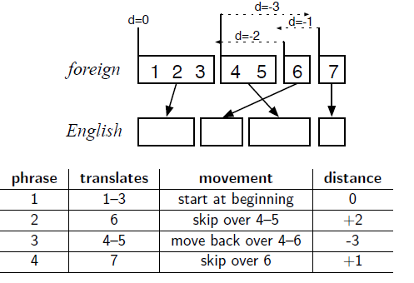
Distance-Based Reordering
distance = start_{i} − end_{i−1} − 1
Reordering distance is measured on the foreign input side.
Dashed arrow indicating the extent of reordering.
For instance the 2nd English phrase translates the foreign word 6, skipping over the words 4–5, a distance of +2.
3/29/2019 SS ZG537 (INFORMATION RETRIEVAL) 60
Pilani Campus
Notes:
In order to generate
phrase1 in english reordering distance = 1-0-1=0
phrase2 in english reordering distance = 6-3-1=2
phrase3 in english reordering distance = 4-6-1=-3
phrase4 in english reordering distance = 7-5-1=1

Slide 61
Distortion Probability: Distance-based reordering
Reordering distance: how many words were skipped (either forward or backward) when generating the next foreign word.
start_{i}: the word index of the first word of the foreign phrase that translates the ith English phrase
end_{i}: the word index of the last word of the foreign phrase that translates the ith English phrase
Reordering distance = start_{i}-end_{i-1}-1
What is the probability that a phrase in the English sentence skips over x foreign words in the foreign sentence?
Two words in sequence: start_{i}=end_{i-1}+1, so distance=0.
How are d probabilities computed?
Exponentially decaying cost function:
Where
Scoring function: d(x) = α^{|x|} – exponential with distance
3/29/2019 SS ZG537 (INFORMATION RETRIEVAL) 61
Pilani Campus
Notes:
instead of estimating the reordering probability from data as well, the reordering is handled by a pre-defined model: an exponentially decaying cost function: d(x) = α ^{|x|} , in this case: d = α ^{|starti−endi−1−1)|} with a value for the parameter α ∈ [0, 1]

Slide 62
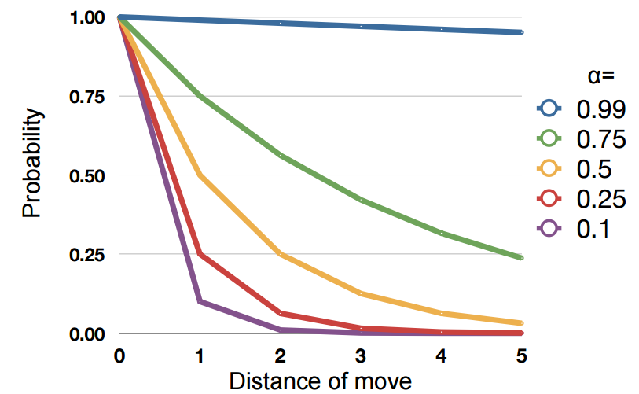
Values of α
3/29/2019 SS ZG537 (INFORMATION RETRIEVAL) 62
Pilani Campus

Slide 63
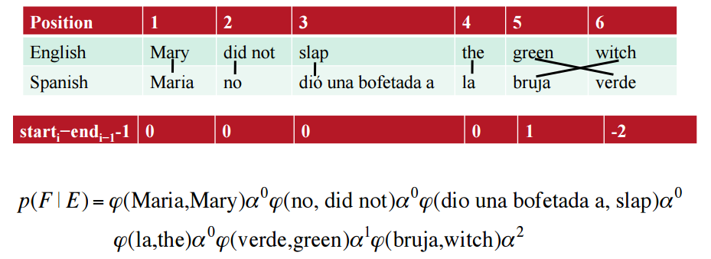
Example for the Translation Model
3/29/2019 SS ZG537 (INFORMATION RETRIEVAL) 63
Pilani Campus

Slide 64
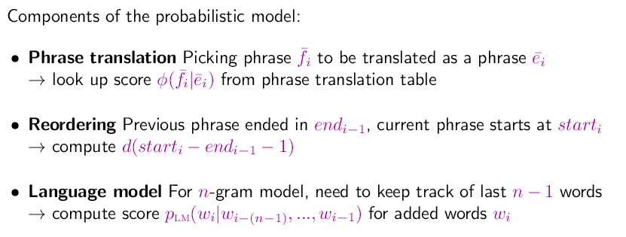

Computing Translation Probability
3/29/2019 SS ZG537 (INFORMATION RETRIEVAL) 64
Pilani Campus
Notes:
there are three components that contribute to producing the best possible translation, by ensuring that
• the foreign phrases match the English words (φ);
• phrases are reordered appropriately (d);
• the output is fluent English (pLM).

Slide 65


Log-Linear Models
We may observe that the words between input and output match up pretty well, but that the output is not very good English.
Hence we can think of giving more weight to the language model.
Introducing weights to each of these components
3/29/2019 SS ZG537 (INFORMATION RETRIEVAL) 65
Pilani Campus
Notes:
Even this relatively simple version achieves generally better translation quality than the word-based statistical IBM models. We will extend the model, achieving further improvement of translation performance.

Slide 66
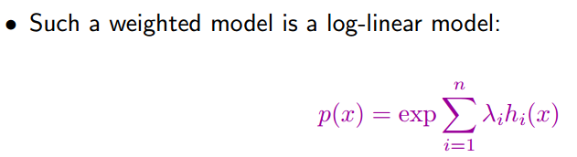
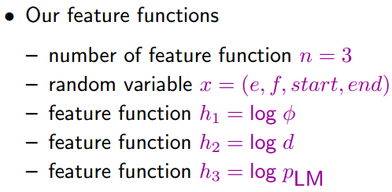
Log-linear models
3/29/2019 SS ZG537 (INFORMATION RETRIEVAL) 66
Pilani Campus

Slide 67
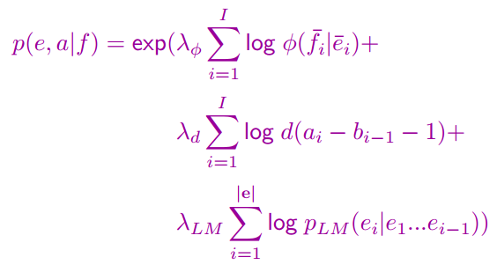
Weighted Model as Log-Linear Model
3/29/2019 SS ZG537 (INFORMATION RETRIEVAL) 67
Pilani Campus

